Slide 1


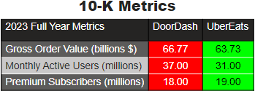
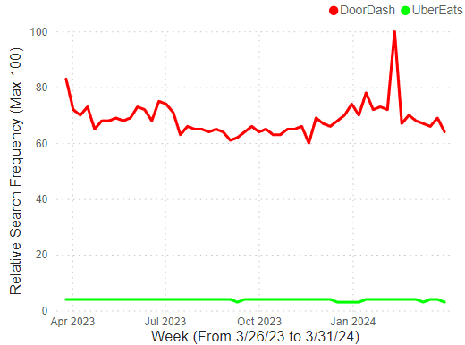
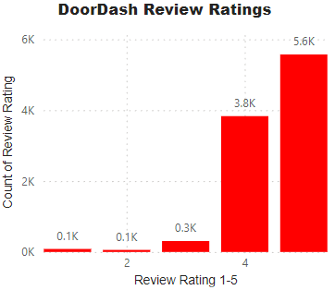
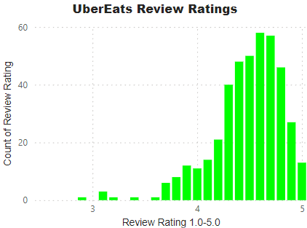
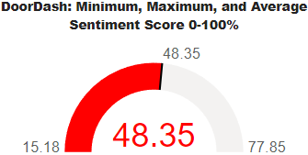
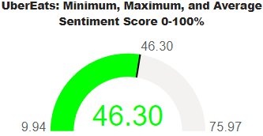
Do Customers Prefer DoorDash or UberEats?
Both services sport similar user counts, premium service subscribers, and gross order values for 2023.
Google Trends Data shows DoorDash holding a significant and consistent lead over UberEats when it comes to Google searches.
Below are the distributions of downloaded reviews followed by sentiment analyses of Instagram captions for both services.
DoorDash
UberEats

